Slide 1
Multi-trait polygenic score generation workflow
A generalized workflow to generate polygenic risk for multiple traits
Notes:
Work in progress
Would love Opinions!
Rick A. Reijnders¹, Ghazi Al Jowf, Ehsan Pishva, (Utrecht team), Laurence de Nijs, Lars M.T. Eijssen, Bart P.F. Rutten
¹ Department of Psychiatry and Neuropsychology, School for Mental Health and Neuroscience (MHeNS), Maastricht University, Maastricht, The Netherlands
² Department of Bioinformatics—BiGCaT, Maastricht University, PO Box 616, 6200 MD Maastricht, The Netherlands

Slide 2
Introduction
Polygenic (risk) score, measure of your disease / trait risk
More feasible as sample sizes continue to grow (2013)
Multi-ancestral work has been slow in most disease areas & standards must critically be adopted (2019)
Limited guidelines (2020)
Dudbridge F (2013) Power and Predictive Accuracy of Polygenic Risk Scores
Martin AR (2019) Clinical use of current polygenic risk scores may exacerbate health disparities
Choi SW (2020) Tutorial: a guide to performing polygenic risk score analyses
Notes:
2011
Therefore, polygenic scores currently have more utility for association testing than predicting complex traits, but prediction will become more feasible as sample sizes continue to grow.

Slide 3
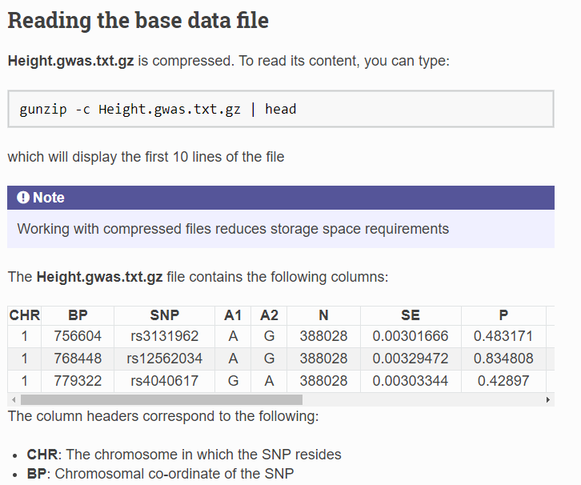
Tutorial: a guide to performing polygenic risk score analyses
Step-by-step
Detailed roughly 40 pages
Annotated
Code
Explanations
Linux, windows batch, R
Choi SW (2020) Tutorial: a guide to performing polygenic risk score analyses

Slide 4
PRS options
PC+T (P-value based clumping and thresholding)
SBLUP
PRS-CS
PRSice-2
LDpred-2
Lassosum
SBayesR
MegaPRS

Slide 5
PRS options
PC+T (default)
SBLUP
PRS-CS
PRSice-2
> LDpred-2
Lassosum
> SBayesR
> MegaPRS

Slide 6
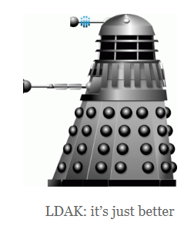
PRS options
PC+T (default)
SBLUP
PRS-CS
PRSice-2
> LDpred-2
Lassosum
> SBayesR
> MegaPRS
https://dougspeed.com/

Slide 7
The situation
Start coding
In linux
In windows bash
Find every parameter
Make it work
Results a scattered script / worflow dedicated to your research question and ‘might’ be ported to other data

Slide 8
The idea
Calculate PRS models
Generate PRS scores
Standardized workflow
Easy to use for us, internally
Preferred in R

Slide 9
The solution
Workflow
Get GWAS (Generate)
Make PRS model (Calculation)
Store models (Internal)
Generate PRS scores (Prediction)

Slide 10
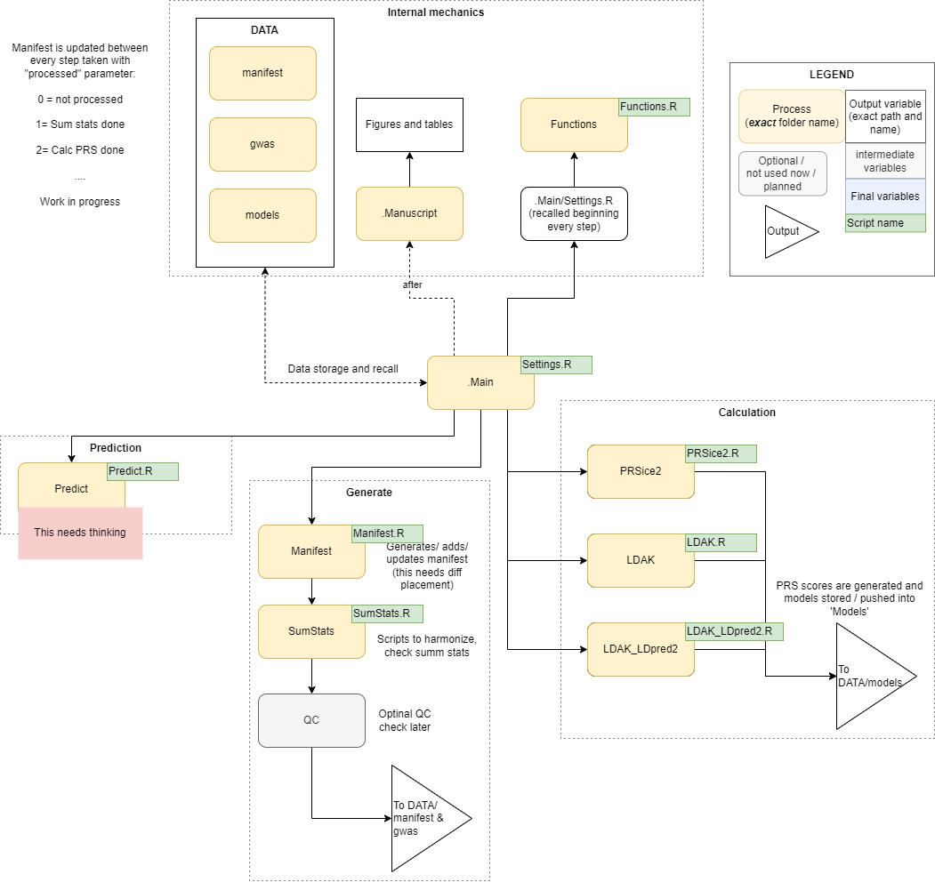
The workflow
Workflow
Get GWAS (Generate)
Make PRS model (Calculation)
Store models (Internal)
Generate PRS scores (Prediction)

Slide 11
The workflow
Workflow
Get GWAS (Generate)
Make PRS model (Calculation)
Store models (Internal)
Generate PRS scores (Prediction)

Slide 12
The workflow
Workflow
Get GWAS (Generate)
Make PRS model (Calculation)
Store models (Internal)
Generate PRS scores (Prediction)

Slide 13
The workflow
Workflow
Get GWAS (Generate)
Make PRS model (Calculation)
Store models (Internal)
Generate PRS scores (Prediction)

Slide 14
The workflow
Workflow
Get GWAS (Generate)
Make PRS model (Calculation)
Store models (Internal)
Generate PRS scores (Prediction)

Slide 15
Current status
All in R
Multiple basic GWAS examples running
Need time to connect objects
(object output to object input)
Needs standardized GWAS input
Then evaluate and plot further course

